Slide 1


Quality Control in Manufacturing
Quality control in manufacturing is a crucial process that ensures products meet predefined standards and specifications. It plays a vital role in delivering high-quality goods to customers, minimizing production losses, and maintaining brand reputation. Quality control methods are implemented at various stages of production, including raw material inspection, in-process checks, and final product evaluation. Effective quality control practices are essential for any manufacturing organization, regardless of its size or industry.
by Virendra Pardeshi

Slide 2
Common Quality Control Methods
1
Statistical Process Control (SPC)
2
Acceptance Sampling
SPC uses statistical techniques to monitor and control manufacturing processes, aiming to identify and eliminate sources of variation that could lead to product defects. It involves collecting data, analyzing trends, and applying corrective actions to maintain consistent product quality.
Acceptance sampling involves inspecting a random sample of products from a batch to determine the quality of the entire batch. This method is often used when it is impractical or cost-prohibitive to inspect every single product. It relies on statistical calculations to make decisions about accepting or rejecting the batch.
3
Visual Inspection
4
Dimensional Inspection
Visual inspection is a basic method that relies on human observation to detect defects. It is often used for simple checks, such as verifying the color, shape, or size of products. However, it can be subjective and prone to human error, especially in situations where subtle defects are difficult to see.
Dimensional inspection uses specialized measuring tools, such as calipers, micrometers, and coordinate measuring machines (CMMs), to verify the dimensions of products. This method ensures that products meet precise tolerances and specifications, which are critical for their functionality and performance.

Slide 3
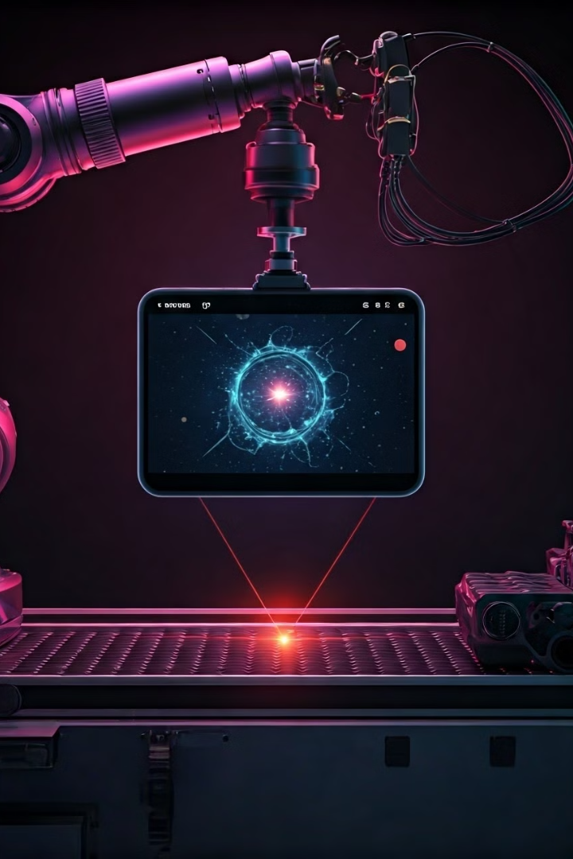
Automated Defect Detection Technique
Automated defect detection techniques use technology to identify and classify defects in products. These techniques are often employed in high-volume manufacturing environments where manual inspection is impractical or inefficient. Common automated methods include machine vision, laser scanning, and ultrasonic testing.

Slide 4
Advantages and Disadvantages of Automated Defect Detection
Advantages
Disadvantages
Increased accuracy and consistency
High initial investment costs
Reduced inspection time
Potential for false positives or negatives
Improved efficiency and productivity
Limited capability for complex defect types
Lower labor costs
Requirement for skilled personnel for system maintenance
Real-time feedback for process optimization
Difficulties in adapting to new product designs

Slide 5

Selecting the Right Technique
Selecting the right quality control technique depends on several factors, including the type of product, the manufacturing process, the desired level of quality, and the budget available. For example, visual inspection might be sufficient for simple products, while more sophisticated techniques like machine vision are necessary for complex products with intricate features. It's essential to carefully evaluate the pros and cons of each technique and choose the one that best suits the specific needs of the manufacturing process.

Slide 6
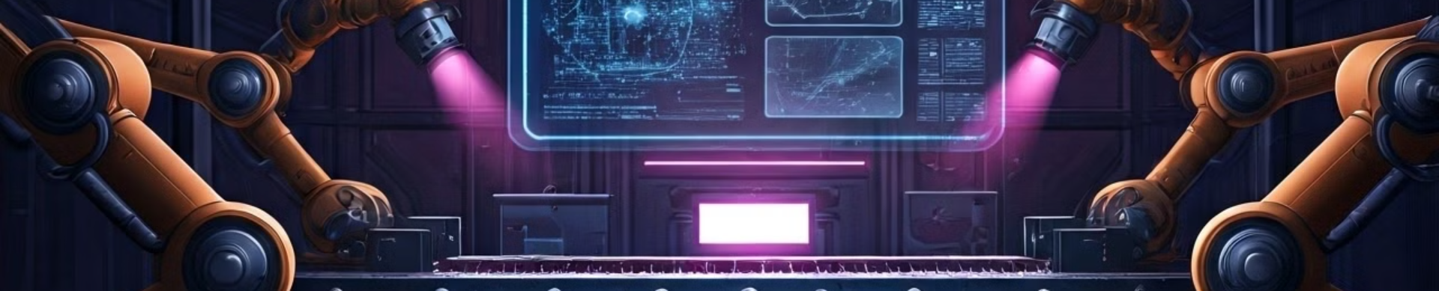
The Case for Machine Learning and Image Processing in Quality Control
Machine learning (ML) and image processing (IP) are emerging technologies that are revolutionizing quality control in manufacturing. These technologies offer significant advantages over traditional methods by providing greater accuracy, speed, and automation. ML algorithms can be trained to identify subtle defects that are difficult or impossible for human inspectors to detect, while IP techniques can analyze images of products in real-time to identify and classify defects. These capabilities allow for more effective quality control, resulting in higher product quality, reduced production costs, and improved customer satisfaction.

Slide 7
Implementing ML and IP for Quality Control
Implementing ML and IP for quality control requires a systematic approach that involves several steps:
1
1. Data Collection
The first step is to collect a large dataset of images of products, including both good and defective examples. This dataset will be used to train the ML model.
2
2. Model Training
The ML model is trained on the collected dataset, learning to identify patterns and features that distinguish defective products from good ones. This involves feeding the model images and labels indicating whether each image represents a defective product or not.
3
3. Model Evaluation
After training, the model is evaluated on a separate set of images to assess its accuracy and performance. This ensures that the model is reliable and can accurately identify defects in real-world scenarios.
4
4. System Integration
The trained model is then integrated into the manufacturing process, where it can be used to inspect products in real-time. This integration typically involves connecting cameras and sensors to the system, which capture images of products and feed them to the ML model.
5
5. Continuous Improvement
The performance of the ML and IP system is continuously monitored and improved. This involves collecting feedback from the system's performance, retraining the model with new data, and refining the system's parameters to enhance its accuracy and effectiveness.

Slide 8





How ML and IP Systems Work for Quality Control
ML and IP systems work by analyzing images of products and identifying patterns that indicate defects. The process typically involves the following steps:
1. Image Acquisition
The system acquires images of products using cameras or sensors. These images can be captured in real-time as products move along a conveyor belt or during offline inspection.
2. Image Preprocessing
The acquired images are preprocessed to enhance their quality and remove noise. This step includes operations like resizing, cropping, and converting the images to grayscale or a different color space.
3. Feature Extraction
Features that are relevant for defect detection are extracted from the preprocessed images. These features can include color variations, shape deviations, texture patterns, and other characteristics that distinguish defective products from good ones.
4. Defect Classification
The extracted features are used to classify the products as either good or defective. This is done by comparing the features to patterns learned during the model training process. The system can also categorize defects into different types, such as scratches, dents, or missing parts.
5. Output and Action
The system outputs the classification results, highlighting any detected defects and providing information about their location and type. This information can be used to trigger automated actions, such as rejecting defective products, adjusting manufacturing processes, or alerting operators for further inspection.

Slide 9
The Process of ML and IP-Driven Quality Control
The process of ML and IP-driven quality control involves several steps, from image acquisition to defect identification and action. Here is a detailed overview:
1. Image Acquisition
1
Cameras or sensors are strategically placed on the production line to capture images of products as they move along the conveyor belt. These images can be captured at multiple angles and resolutions to ensure comprehensive inspection.
2
2. Data Preprocessing
The acquired images are preprocessed to remove any noise or distortions that might interfere with defect detection. This includes adjusting brightness, contrast, and color balance, as well as performing image filtering and edge enhancement.
3. Feature Extraction
3
The preprocessed images are analyzed to extract features that are relevant for defect detection. These features can include shape, size, color, texture, and other characteristics that distinguish defective products from good ones. Different feature extraction techniques are available, depending on the type of defects being targeted.
4
4. Defect Classification
The extracted features are fed into a trained machine learning model that classifies the products as either good or defective. The model uses algorithms to identify patterns and anomalies in the features, based on its training data. The classification results can also indicate the type of defect detected.
5. Action
5
Based on the classification results, the system triggers appropriate actions. Defective products can be automatically rejected and sent for rework or disposal. Alternatively, the system can alert operators for manual inspection or adjust manufacturing processes to minimize future defects.

Slide 10
Optimizing Quality Control with ML and IP
ML and IP offer numerous advantages for optimizing quality control in manufacturing. By leveraging these technologies, manufacturers can achieve significant improvements in product quality, efficiency, and cost savings. Key takeaways include:
Increased Accuracy
Improved Efficiency
ML and IP systems can detect subtle defects that are difficult or impossible for human inspectors to see. This leads to higher product quality and reduced customer complaints.
Automated defect detection allows for faster inspection times, enabling manufacturers to process products more efficiently and reduce production delays. This also frees up human inspectors to focus on more complex tasks.
Reduced Costs
Data-Driven Decision Making
By minimizing defects and reducing rework, ML and IP systems can significantly reduce production costs. They also lead to lower labor costs as fewer inspectors are required for manual inspection.
These systems collect valuable data that can be used to identify trends and patterns in product quality. This data can be used to improve manufacturing processes and prevent future defects.

